Slide 1
WHY BIOMASS?
Alaska Wood Energy Conference
Fairbanks, Alaska
April 15-16, 2019
maureen.scott@canada.ca
Natural Resources Canada
Notes:
I recently returned from a trip to Nepal, and I noticed that when I would ask a Nepalese person a question that started with why, they would shrug their shoulders, and answer, ‘why not’.
This seemed like a reasonable response, and one that could answer the question ‘why biomass’, but would make for a very quick presentation. So I thought I should dig deeper into the subject.
Before I start, I have a confession to make. Its not a ‘forgive me father for I have sinned’ type of confession; its more of a disclosure.

Slide 2
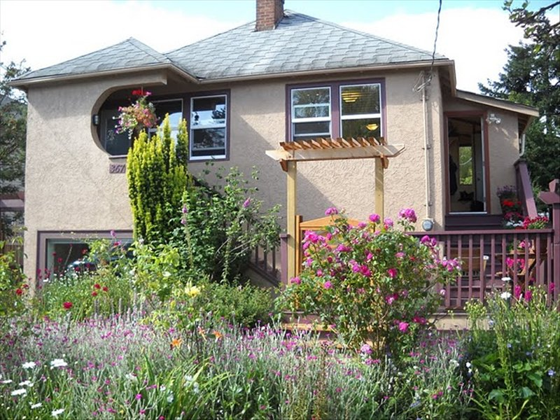
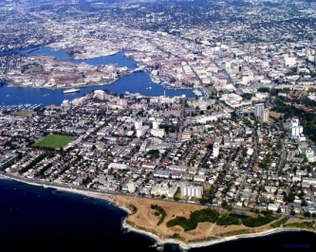

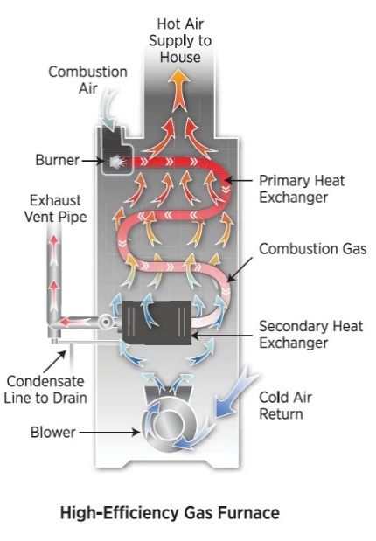
DISCLOSURE
Victoria, BC
Notes:
First, I am a Canadian.
I live in Victoria, BC, which is a fairly large city
I Drive a gas car, and live in a house heated with natural gas.

Slide 3

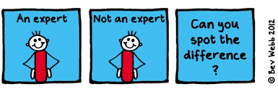
NOT
Notes:
And, hello, I am not an expert on bioenergy, biomass, GHG, climate change.
So, what am I, a city dwelling, gas guzzling, non-expert foreigner doing up here talking to you about bioenergy?

Slide 4
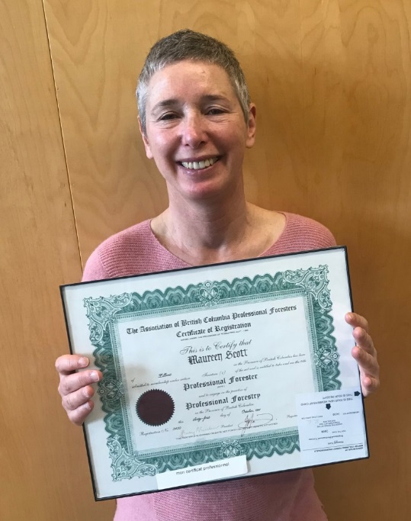
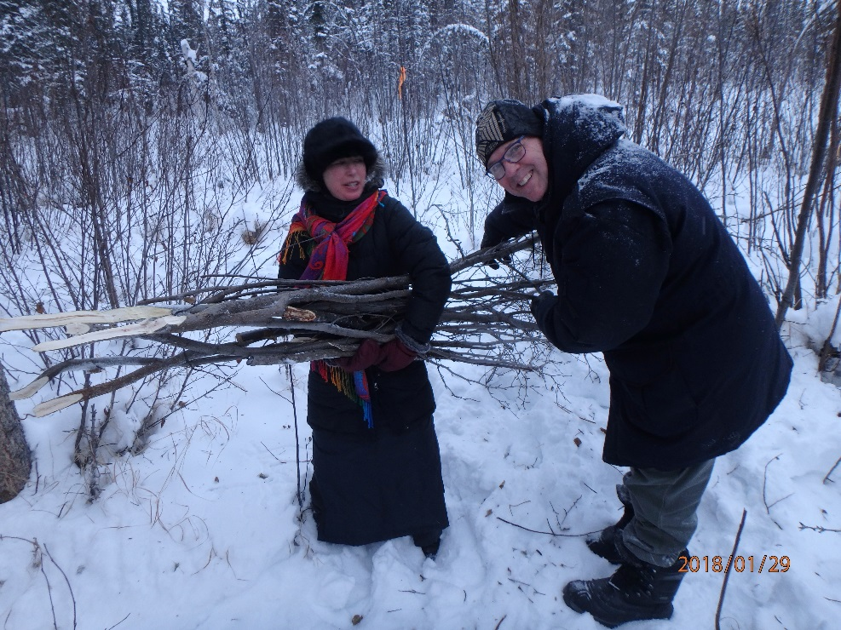
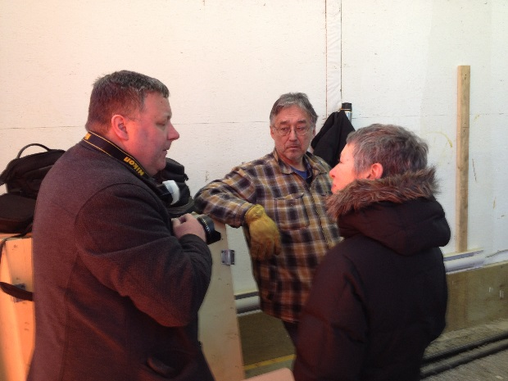
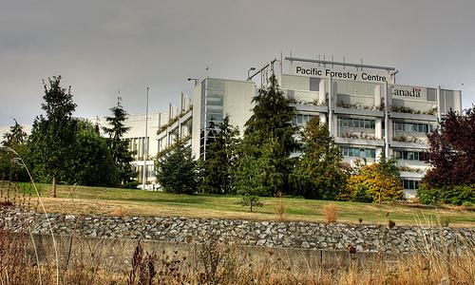
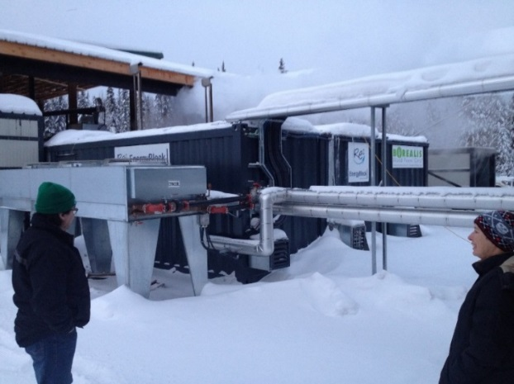
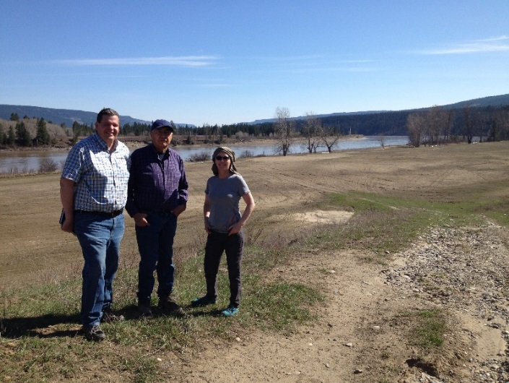
Notes:
Here is what I am, and bring to this conference. I am a registered professional forester in BC.
I work for the Canadian government at the Pacific Forestry Centre, Canadian Forest Service, Natural Resources Canada. PFC is one of six regional forestry research centres across Canada. And we have many people working there who are experts in bioenergy, and climate change.
In my career as a forester I have worked with First Nations in BC for 25 years on forestry projects and operations.
For the past six years I’ve been working as a forestry officer for natural resources canada with indigenous communities in bc and yukon on bioenergy projects. My knowledge and experience is from visiting communities who are developing bioenergy projects, talking to the many experts who are researching bioenergy, and attending conferences like this. So I do know a little something about bioenergy.
In fact, The other day, I was asked to give an interview on bioenergy for the Yukon Gov. Fortunately, she asked me questions that I had researched for this talk, so I was able to give fairly coherent responses. One question she asked was, ‘why is the government of canada supporting bioenergy projects?”. I was like, pick me, pick me, I know the answer to this one!!

Slide 5
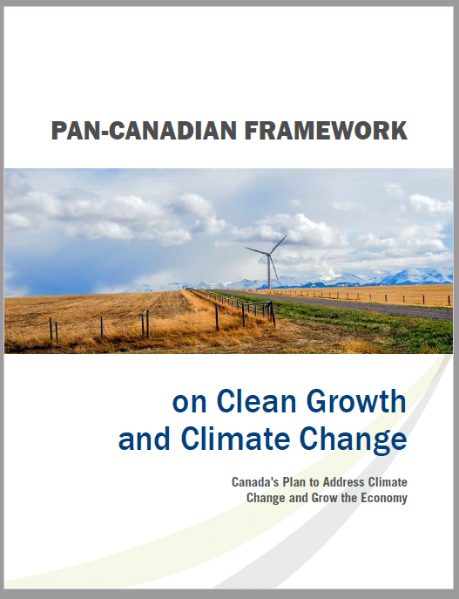
WHY CANADA SUPPORTS BIOENERGY INITIATIVES
The Pan-Canadian Framework on Clean Growth and Climate Change is Canada’s plan – developed with the provinces and territories and in consultation with Indigenous peoples – to meet our emissions reduction targets, grow the economy, and build resilience to a changing climate.
The Framework commits to reducing GHG emissions by supporting rural and remote communities in their transition toward more secure, affordable, clean energy.
Notes:
The federal government has adopted several policies to support forest bioenergy, and acknowledge its role in a low carbon economy in Canada.
The 2016 Pan-Canadian Framework on Clean Growth and Climate Change was developed with the provinces and territories to meet canada’s emissions reduction targets, grow the economy, and build resilience to a changing climate.
One of the commitments in the framework is to reduce GHG emissions by supporting rural and remote communities in their transition toward more secure, affordable, clean energy

Slide 6
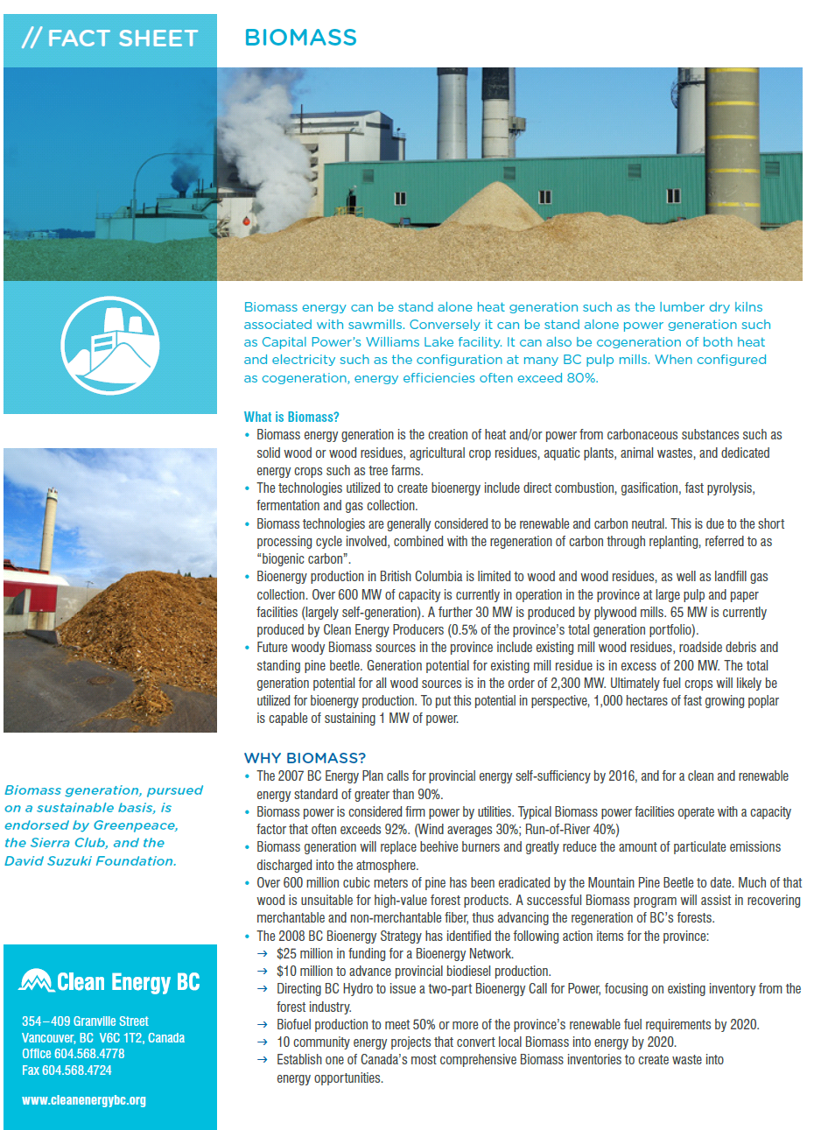
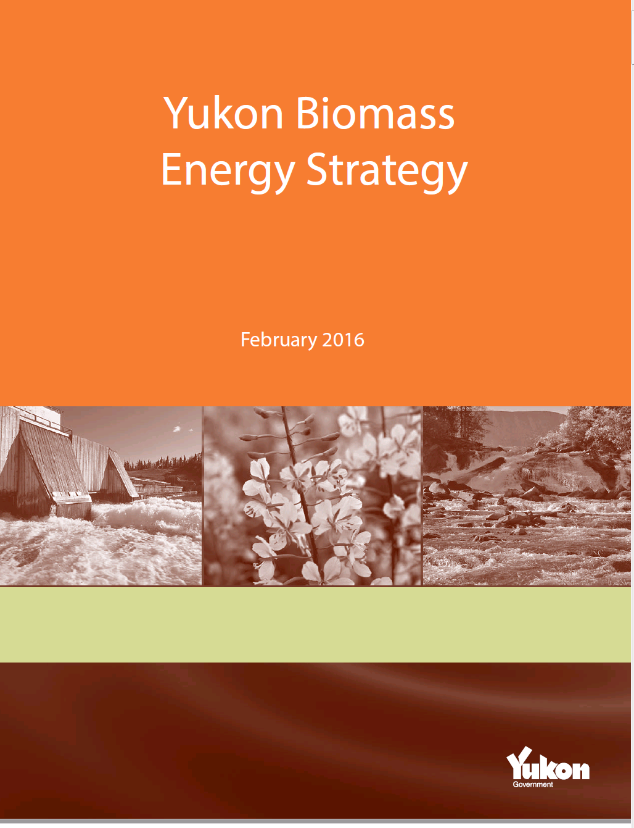
BC AND YUKON BIOENERGY STRATEGIES
Clean Energy BC
Notes:
The bc and yukon government have also developed strategies and policies that support bioenergy.
The yukon bioenergy strategy that Ryan Hennessay mentioned yesterday was approved in 2016. More recently, the BC government rolled out the clean energy BC plan, which includes development of bioenergy.
Some of the programs that were initiated as a result of the government of canada’s commitment are the IFI, and CERRC.

Slide 7
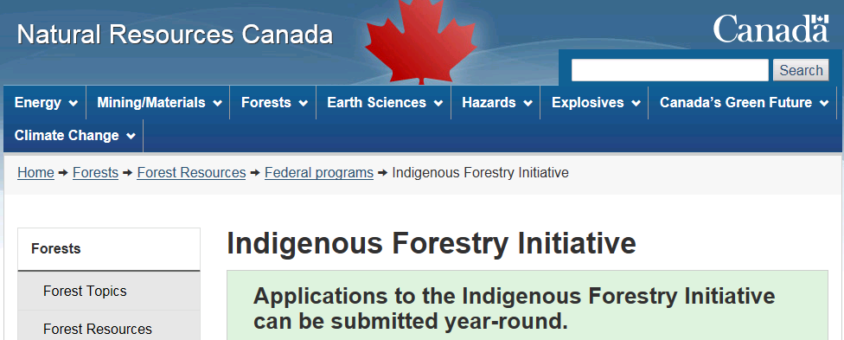
GOVERNMENT OF CANADA BIOENERGY INITIATIVES
Indigenous Forestry Initiative:
focuses on economic development and forestry,
with a bioenergy component
Strategic Partnership Initiative:
focuses on promoting participation
in the forest bioeconomy
Notes:
The Indigenous forestry initiative is a national program that focuses on forestry projects and economic development in indigenous communities. One of the streams is for projects that are related to bioenergy and the bioeconomy.
The Strategic Partnership Initiative is a program that is specific to promoting bioenergy in northern indigenous communities, especially communities that rely on diesel fuel.

Slide 8
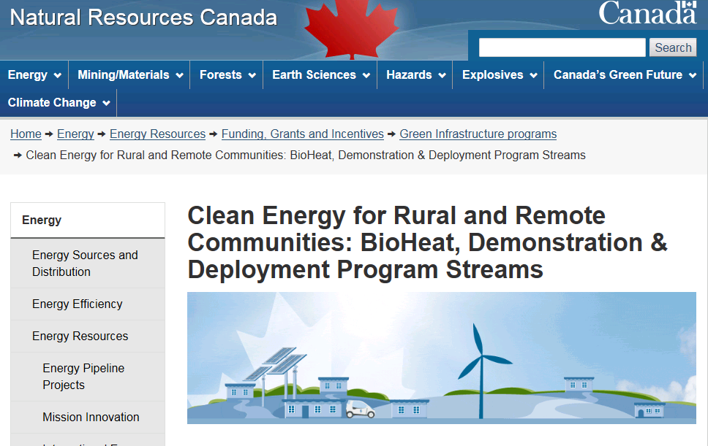
GOVERNMENT OF CANADA BIOENERGY INITIATIVES
Clean Energy For Rural and Remote Communities:
Bioheat Stream
focus on capital projects to develop biomass heating systems
and reduce fossil fuels in remote communities
Notes:
The clean energy in rural and remote communities (CEERC) is also a program delivered by NRCan. The objective is to reduce reliance on fossil fuels in rural and remote communities. There is a bioheat stream, which supports the adoption of biomass heating or combined heat and power.

Slide 9
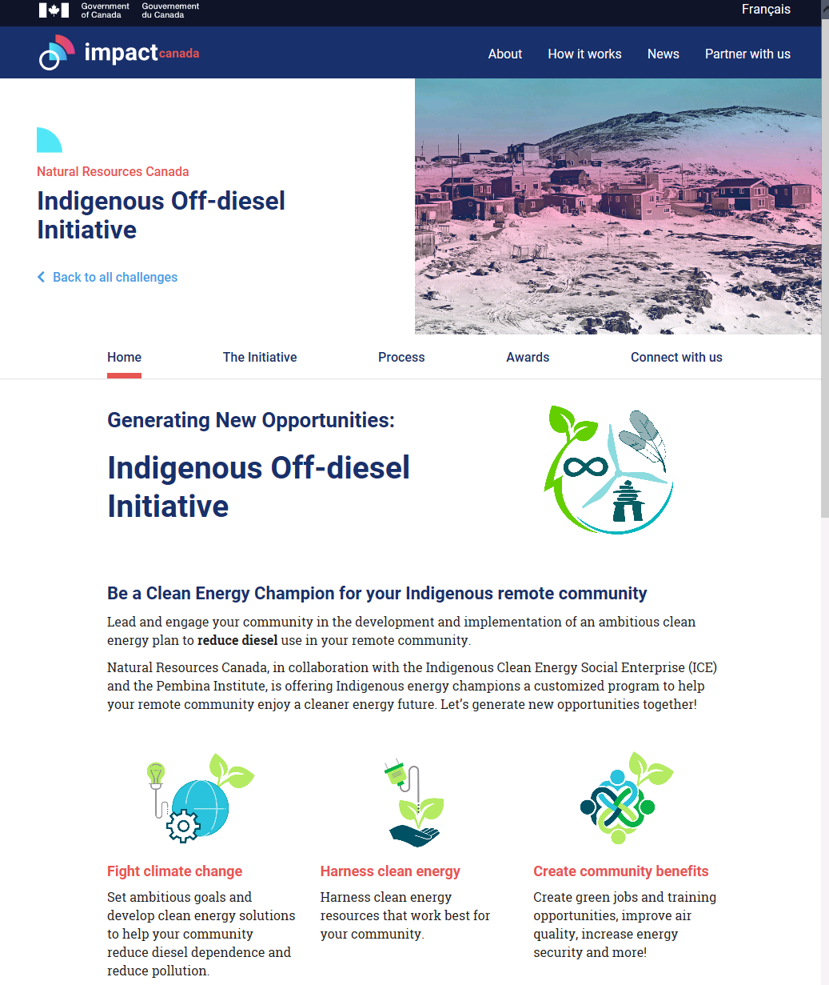

GOVERNMENT OF CANADA BIOENERGY INITIATIVES
Indigenous Off-Diesel initiative:
Aimed at reducing diesel reliance in remote
Indigenous communities through supporting leaders
that can develop renewable energy solutions
in their communities
Notes:
A newly announced program by the government of canada is the indigenous off diesel initiative. This program is delivered in collaboration with the indigenous clean energy social enterprise and the Pembina Institute. Selected communities will receive funding and hands on support to develop a community driven energy plan and implement their plans.
I would now like to introduce you to some of the projects that I have been involved with.

Slide 10
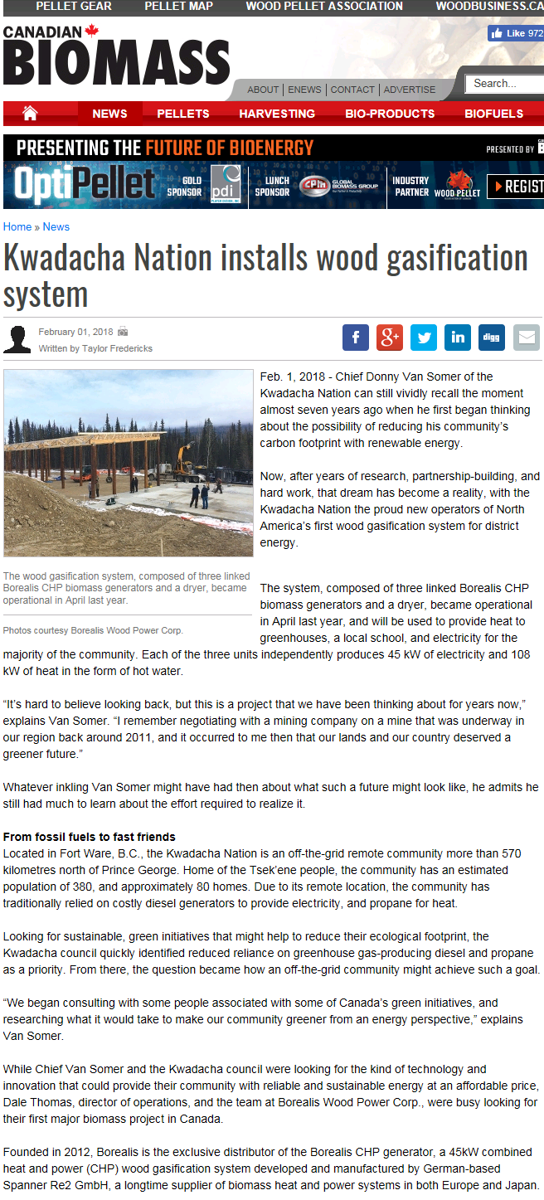
BIOENERGY PROJECTS IN BC AND YUKON
Kwadacha First Nation: CHP Project
Notes:
Kwadacha first nation is in north eastern bc, in fort ware.
They installed a spanner chp system about three years ago, and it has been running since. It provides electricity to the community and heat to the school and greenhouse. They are producing veggies in the greenhouse, and I got to see some of the produce in a store when I was visiting the neighboring community of of tseh key dene.
From what I hear the system is running well. There is an issue around the amount to fines that are produced from chipping. They are looking into purchasing briquette manufacturing equipment to make use the fines.

Slide 11
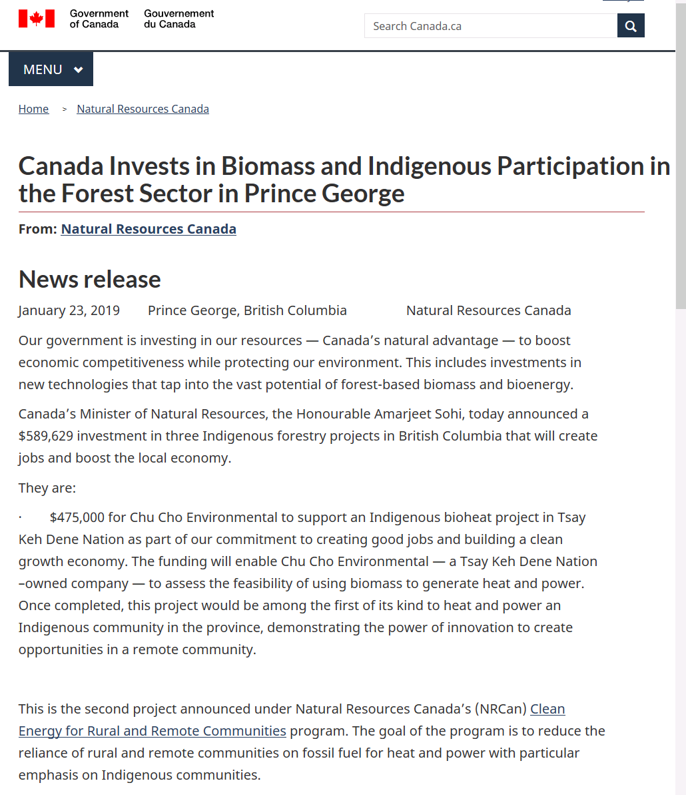
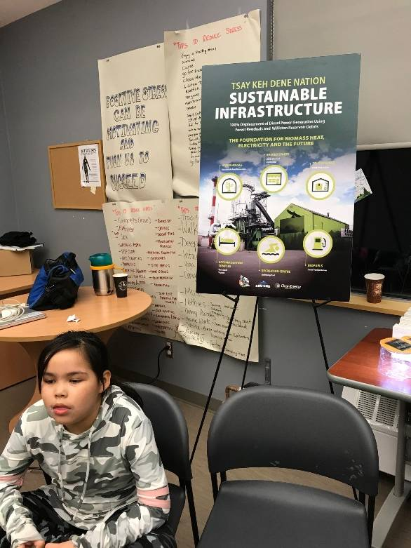
BIOENERGY PROJECTS IN BC AND YUKON
Tsay Keh Dene: CHP Project
Notes:
Tsey keh dene is also in north eastern bc, located on Williston reservoir.. They have been investigating installing a CHP system into the community for many years; the project has been resurrected and they are currently working on a power agreement with bc hydro. The intent is for the system to be powered using log debris that remained in the reservoir after the Williston lake was flooded to construct the WAC bennet dam. This debris is collected from the reservoir as it’s a safety hazard and burned in piles. I was recently at a community engagement event hosted by Tsey Keh Dene, and there was huge support for the project.

Slide 12
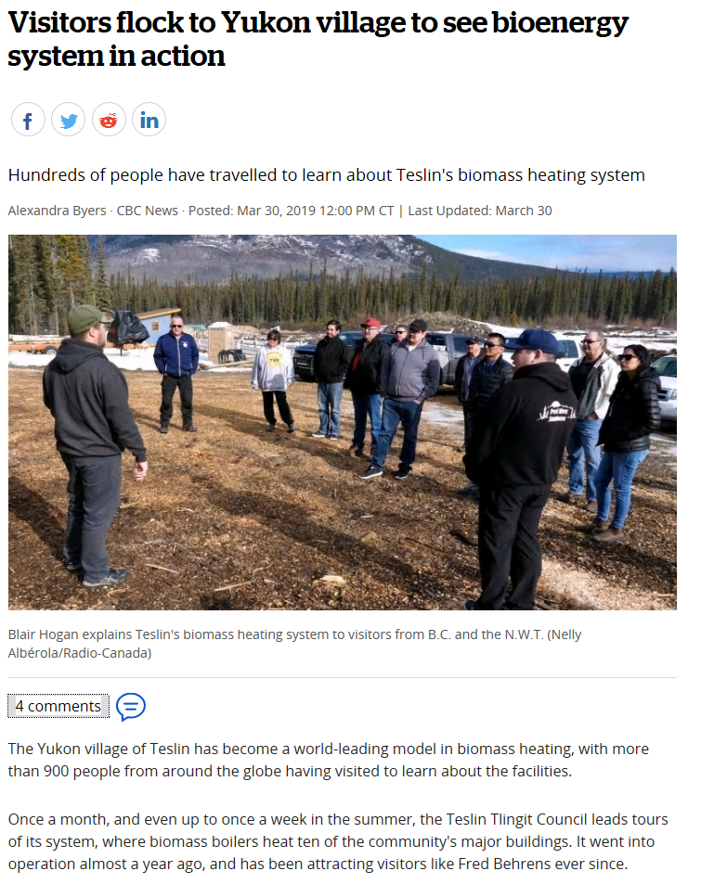
BIOENERGY PROJECTS IN BC AND YUKON
Teslin Tlingit Council – Hargassner biomass boiler district heating system.
Notes:
Most of you are now familiar with the Teslin project. We toured there last week, and believe me, I have never seen so many people so excited about heating. They love talking about the project and showing off their red hot hargassner units. NRCan was there when they bought their first 10 units and now they are installed in housing units, and have a chip storage shed and are looking into purchasing and installing more units.

Slide 13
FEEDBACK FROM FOREST BIOMASS PROJECTS
Energy cost savings from systems that burn wood more efficiently.
Local economic development and jobs.
Training, employment and business opportunities.
Decreased costs and risk of impacts from transportation/use of fossil fuels.
Energy independence and keeping $$ in the community.
Use of forest residues from other forestry activities and construction projects.
Use of dead wood and fire smart residuals.
Community pride.
Members returning to the community because of employment opportunities.
Makes sawmilling profitable if there is a market for the waste.
Investment in future of community
Notes:
These are some of the comments that I have heard from communities that are using bioenergy.
There seems to be a lot of pride that are associated with these systems.
One fellow we visited last week said that the purchase of this biomass system ‘changed his life”. He calls the machine his sweetheart.

Slide 14
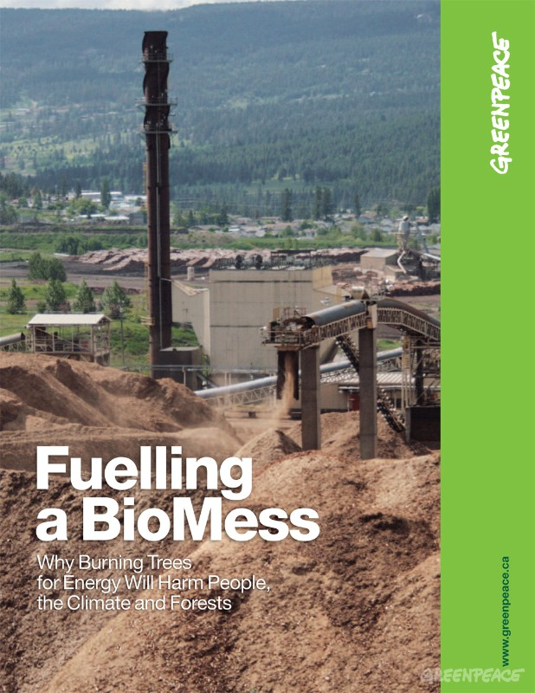
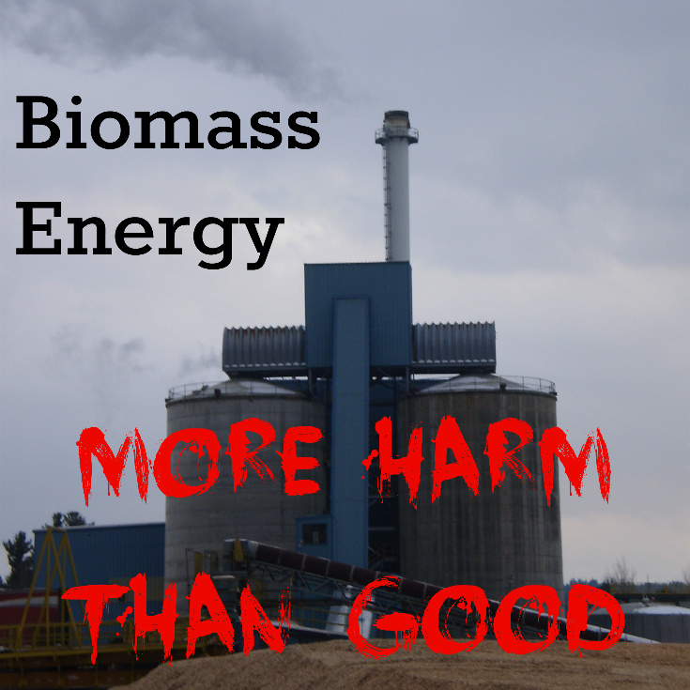
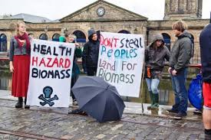
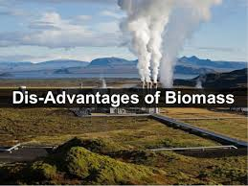
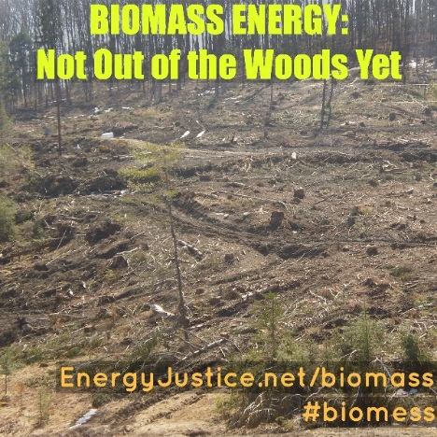
Notes:
So with all the positive aspects of bioenergy, why do we see images like this?
And headlines like this…

Slide 15

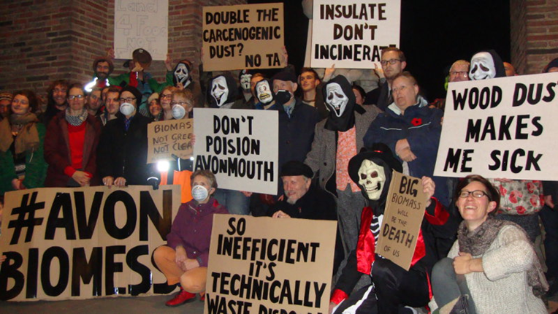
“Burning forest biomass to make electricity releases substantially more carbon dioxide per unit of electricity than coal”.
“We see this biomass industry as one of the biggest threat to these forests”.
“I'm far from convinced that the biomass industry is policing itself, or being policed, forcefully enough.”
“The most dangerous component of combustion is the particulate matter which is produced by biomass power generation”.
Burning trees for energy ‘like pouring gasoline to put out a fire’
Notes:
Adam sherman touched on this in this talk yesterday.
He talked about some of the reasons these perseptions exist.

Slide 16
????????
Notes:
So my burning question became – how much truth is there to these comments? Is bioenergy bad?
As I mentioned earlier I work with experts in the field of bioenergy, so I thought I would put some questions to them.
Dr. Kurz is a senior research scientist at PFC, and leads the national carbon accounting.
Dr. Brian Titus is part of a collaborate team researching site sensitivity to biomass harvesting.
Dr. Carolyn Smith is a member of the carbon accounting team and is researching ghg mitigation options including biomass.

Slide 17
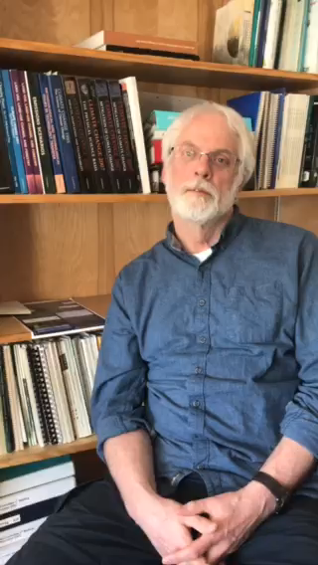
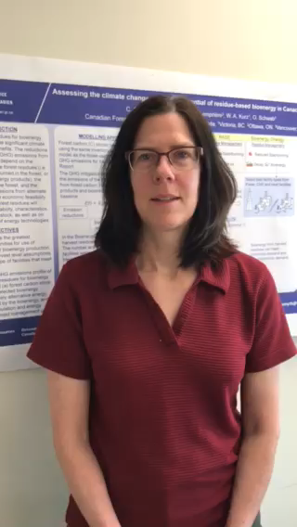
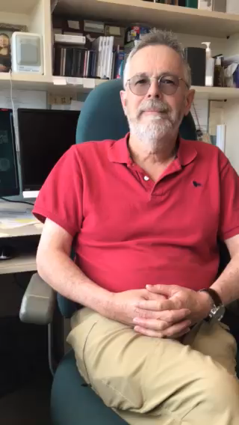
I WORK WITH SMART PEOPLE
Notes:
I had some nifty videos with the three of them answering my questions, but the videos don’t work, so I will have to play all the roles.
I asked Dr. Kurz - does the use of bioenergy reduce greenhouse gas emissions? Response – “it depends”.
I asked Dr. Titus- will using forest biomass for heat and energy effect the sustainability and productivity of forests? Response – “it depends”.
I asked Dr. Smyth, can use of bioenergy help mitigate climate change? Response – “it depends”.
So, what I am hearing is that it depends. But I don’t thing the discussion about bioenergy can be put into sound bites; the discussion needs to be put into context. Are you talking about generating heat or electricity? what is the scale of the project? are you discussing the benefits with regards to ghg emissions, or economics, or social aspects?
For example, according to Dr. Smyth, From a ghg emissions perspective, the benefits of GHG reductions may not be realized for many years to many decades. And the time required to achieve net ghg reductions depends on a few factors.

Slide 18
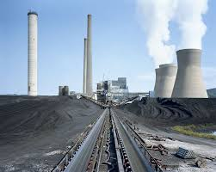
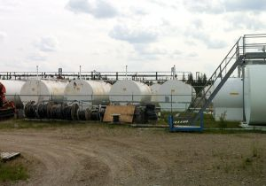
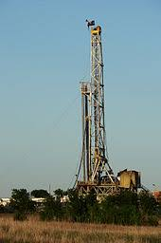
IT DEPENDS: WHAT FOSSIL FUEL ARE YOU DISPLACING
Natural gas
Coal
Diesel in off-grid communities
Notes:
The reduction in ghg will be different depending if one is offsetting or replacing natural gas versus diesel.

Slide 19
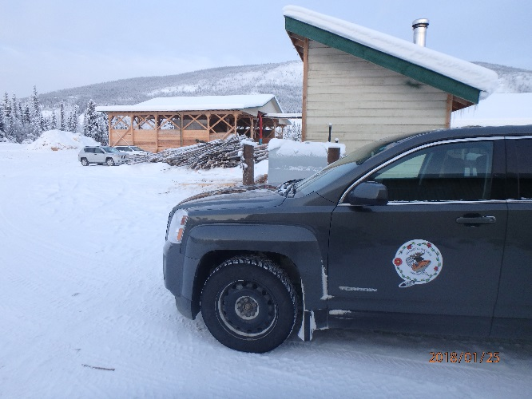
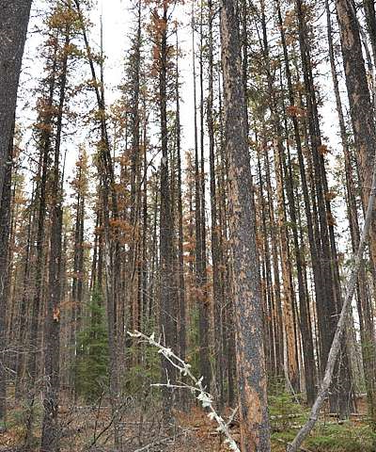
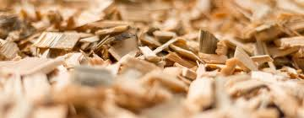
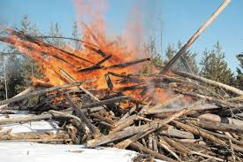
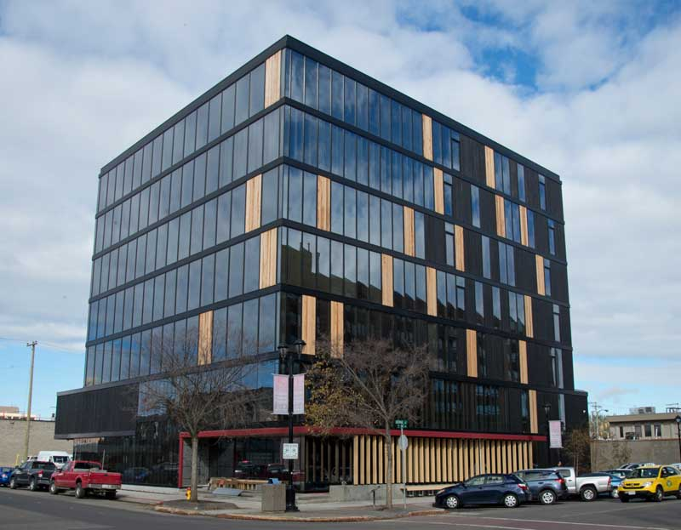
IT DEPENDS: WHAT IS THE SOURCE OF FEEDSTOCK
Notes:
When discussing ghg mitigation and benefits, you have to consider the feedstock source. Nrcan is developing qualitative criteria for assessing bioenergy projects for maximum ghg mitigation potential. Some factors to consider regarding feedstock:
Is there a sustainable, local source of wood, that if left unused would release carbon rapidly to the atmosphere through decay or slash burning - Such as dead wood, mill residues, or forest residuals,
Is there a source of wood from fire smart activities, insect/disease removal or other stand improvement activities?
Can feedstocks be acquired without reducing the productivity of the site.
Is the wood prioritized and sorted so wood is first used for longer lived wood products, then products at the end of their lives used for bioenergy.
The next slide is meant to summarize the complexity of the discussion on bionenergy and climate change mitigation.

Slide 20
IT DEPENDS: GHG AND CLIMATE MITIGATION
Biomass comes from a dynamic natural system that continuously sequesters from, and releases carbon to, the atmosphere.
The use of biomass for bioenergy can be carbon positive, negative or neutral.
It depends on the assumptions made when calculating the carbon impact of bioenergy use.
To compare energy sources, a full life-cycle accounting of all carbon emissions and sequestration is required.
Notes:
But everyone in this room knows that the decision and debate around biomass is not just about greenhouse gas and climate change.

Slide 21
IT DEPENDS: BIODIVERSITY AND SUSTAINABILITY
Sustainable forest management planning must guide biomass practices.
When evaluating the impact, must consider the baseline or alternative use.
The over removal of dead trees or woody residue could reduce the stock of coarse woody debris with possible negative impacts on biodiversity and soil fertility.
Notes:
Solid forest management decisions must be made when planning a bioenergy project.
The impacts on the ecosystem may depend on the existing land use. For example, in yukon where there hasn’t been a forest based economy, an increase in harvesting to support a bioenergy economy could have an impact on the land base.

Slide 22
IT DEPENDS: ECONOMIC BENEFITS
Potential economic benefits/revenue from bioenergy:
Selling power
Construction of facilities
Feedstock collection
Tourism
Products
Use of local fuel source versus trucking in diesel
Stability of a local fuel source
Notes:
And of course there is the economic decisions. In smaller remote communities there are often positive benefits from biomass projects when they involve sourcing the wood locally.

Slide 23
How do we have a balanced dialogue about bioenergy?
Notes:
What I learned in my investigation into bioenergy is that you can’t really classify bioenergy into good or bad.
A better question is how do we have science-based conversations about bioenergy that are isn’t based on rhetoric, hyperbole, and sensationalism.
There are some valid concerns as well as a lot of misinformation.
This is where I am reaching out to you dear audience. I am hoping that you – the experts, practitioners and users of bioenergy can help.
I would like to know about the challenges and successes that you had discussing your projects
To begin this discussion, I want to share with you an article. A few weeks ago, CbC radio did an article about the Teslin biomass project. They interviewed Blair Hogan, and the director of my program Laura Mackenzie and the Honerable Raj Pillai, and I thought they gave an good account of the project.
I’d like to show you some comments that were posted on the cbc website in response to the article.
23

Slide 24
HOW TO HAVE A DISCUSSION ABOUT BIOENERGY
Comments from CBC Website regarding the Teslin Article:
“Biomass is not a great long-term solution to diesel power generation. For one, it is a myth that it is 'carbon neutral'. According to the IPCC, compared to natural gas, the burning of wood puts out 2 times more CO2, 60 times more methane and 400 times more Nitrous Oxide (N2O) for each unit of energy burned. It also puts out more CO2 and N2O than the burning of oil or even coal.
It also releases a huge amount of fine particulate matter (PM2.5) which is very harmful to people's health. So if it is located near communities it could be creating a lot of harm, increasing health impacts and, therefore, costs. Is there any air quality testing set up as part of this? Are there any health studies mandated to assess the impacts?
And what happens when all the Fire Smart wood in the area is harvested? Biomass plants demand an ongoing source of wood for decades to come, that can outstrip the supply of wood chips (which are being shipped from where?) and lead to harvesting of live trees”.
Notes:
I am not using this to deride or criticise this person. They bring up some important and valid issues, and I would like to use this example as a starting point for discussion.
What id like to do is go through the comments and call on you the audience to think about the comments and how you might respond or react.
I am not looking for comprehensive answers or rebuttals; I would like get people thinking about some of the common concerns that people voice about bioenergy, how these concerns may relate to their projects, and how to construct a dialogue.

Slide 25
CONCERNS REGARDING THE MYTH THAT BIOMASS IS CARBON NEUTRAL
Comments from CBC Website regarding article on the Teslin Biomass Project:
# 1: “Biomass is not a great long-term solution to diesel power generation. For one, it is a myth that it is 'carbon neutral‘”.
Biomass Energy: A clean and renewable Fuel:
“Contrary to what many people think, biomass is very environmentally friendly fuel.
Growing trees capture and feed on CO2, which is present in the air. When wood is burned, CO2 is released into the atmosphere restarting the cycle. This is why biomass is considered neutral for the production of GHG unlike all the fossil fuels that pollute the atmosphere”.
The knowledge of carbon accounting has evolved.
Canadian scientists are moving away from using the term carbon neutral when discussing forest biomass.
We should have consistent messaging on bioenergy and GHG.
Notes:
The first comment brings up the issue of carbon neutrality, which was introduced by the previous speaker.
One company that manufactures boilers uses the term carbon neutral on their website.
However, scientists at NRCan are moving away from the term with the realization that the discussion is more complicated than the term implies. Perhaps industry should also change their terminology.

Slide 26
CONCERN AROUND C02 AND N20
Comments from CBC Website regarding article on the Teslin Biomass Project:
# 2: “According to the Intergovernmental Panel of Climate Change (IPCC), compared to natural gas, the burning of wood puts out 2 times more CO2, 60 times more methane and 400 times more Nitrous Oxide (N2O) for each unit of energy burned. It also puts out more CO2 and N2O than the burning of oil or even coal”.
Conclusions regarding deployment: Key
messages about bioenergy
Bioenergy has significant potential to mitigate GHGs if resources are sustainably developed and efficient technologies are applied.
Forest products and biomass residues and wastes can deliver significant GHG mitigation performance—an 80 to 90% reduction compared to the fossil energy baseline.
Special Report on Renewable Energy
Sources and Climate Change Mitigation
Summary for Policymakers: A Report of Working Group III of the IPCC
Notes:
This is another extremely complicated topic, and I would like to call upon member of the audience to share their input here.

Slide 27
CONCERN REGARDING EMISSIONS AND HEALTH
Comments from CBC Website regarding article on the Teslin Biomass Project:
# 3: “It (burning of wood) also releases a huge amount of fine particulate matter (PM2.5) which is very harmful to people's health. So if it is located near communities it could be creating a lot of harm, increasing health impacts and, therefore, costs. Is there any air quality testing set up as part of this? Are there any health studies mandated to assess the impacts”?
Modern boilers / stoves have much lower emissions than conventional stoves because they use advanced emissions control technologies. Most modern equipment is imported from Europe and meet stringent European standards. Canadian Council of Ministers of the Environment are currently developing a guide for managing air emissions from small scale combustion systems (between 50kW and 5MW). Larger systems would require permitting / authorization from provincial bodies.
The International Organisation for Standardisation (ISO) has developed standards for solid biofuels which have been adapted by the Canadian Standard Association (CSA).
Notes:
Chad provided some excellent information yesterday on emissions and PM2.5.
I had conversations with my colleague from NRCan Sadnem and Dave Dubois, and they also provided some insights into this discussion.
The first bullet talks about new improved technology, and the standards that must be met in Canada. Many of the projects I am involved with are replacing inefficient wood heating stoves and diesel.
Standardizing the quality of fuel will result in more efficient systems and reductions in emissions.

Slide 28
CONCERN REGARDING WOOD SUPPLY AND SUSTAINABILITY
Comments from CBC Website regarding article on the Teslin Biomass Project:
# 4: “And what happens when all the Fire Smart wood in the area is harvested”?
# 5: “Biomass plants demand an ongoing source of wood for decades to come, that can outstrip the supply of wood chips (which are being shipped from where?) and lead to harvesting of live trees”.
Firesmart activities are usually not a one entry treatment
Harvesting of live trees specifically for biomass energy use is a valid point of concern.
In the case of Teslin Tlingit Council, they are sourcing feedstock from several sources including:
Trees that were removed for construction and road building;
Fire killed trees;
They also plan to use sawmill residuals when the sawmill becomes operational.
Notes:
The use of live whole trees for biomass may be a valid concern. However with respect to the teslin project.
According to one of the project managers, there are several sources of feedstock that are being used to run the boilers including:
Trees that were removed for construction and road building;
Fire killed trees
Fire smart activities,
Plan to use sawmill residuals when the sawmill becomes operational

Slide 29
LESSONS I LEARNED: HOW TO HAVE A BALANCED DISCUSSION
Be respectful of other’s opinions.
When having discussions, you got to know when to hold ‘em, know when to fold ‘em, know when to walk away, and know when to run.
Using terms like good/bad/carbon neutral does not help.
It might help to change the terminology e.g. advanced wood heat.
The science around bioenergy is complicated, multi-faceted and evolving.
Put the conversation into context and be specific and clear on assumptions.
Notes:
Here are some lessons I learned through this exercise.

Slide 30
CHALLENGE
KEEP LEARNING AND EDUCATING YOURSELVES AND OTHERS ON BIOENERGY
BRING YOUR PASSION TO THE DISCUSSION
ALSO BRING CREDIBILITY TO THE DISCUSSION
Notes:
My challenge to the audience.
You can’t argue with passion.

